Slide 1
Human–Computer Interaction
Evaluation in theory
Ann Blandford

Slide 2
Aims of this session
By the end of this session, you should:
  Have an overview understanding of different approaches to usability evaluation
  Be able to apply Heuristic Evaluation and Cognitive Walkthrough

Slide 3
What and why?
What is usability evaluation?
Why does it matter?
When does it take place in the design process?

Slide 4
A taxonomy of techniques (reminder)
With or without users
  aka empirical vs analytical
  Empirical: Qualitative vs quantitative
  Controlled vs with ecological validity
With or without the computer
  Empirical: system testing vs surveys
  Analytical: heuristic evaluation vs cognitive walkthrough

Slide 5
Some reasons not to involve users?
Which of the following reasons are good ones for not involving users in evaluation of a system?
  It’s difficult to contact users of the system.
  There aren’t many users so only use them when you think the system is as good as it can be.
  Users won’t understand the innovations of the system.
  Working with users is expensive and time-consuming.

Slide 6
Examples of analytical techniques
Expert review
  You are an “expert”; you work through a system identifying potential usability difficulties.
  Challenge: can’t do it if you were involved in the design
Heuristic Evaluation
  “Rules of thumb” (rather like principles) that a design should satisfy
Cognitive Walkthrough
  Inspection technique based on the idea that users are exploring the system with a goal in mind
GOMS
  Goals, Operators, Methods, Selection rules
  Technique based on cognitive modelling that focuses on expert users
  Not studying this at all: you should be aware of the term

Slide 7
Heuristic evaluation
Asks 10 questions about every screen / system state.
Deals with surface aspects of design such as existence of feedback, appropriateness of labels.
Probably the most widely used approach in industry.
See www.useit.com for details

Slide 8
Heuristic evaluation
Jacob Nielsen
A heuristic is a “rule of thumb”
A set of heuristics provides a structure for evaluating a system – like a checklist
When evaluating a system, you need to work systematically through the system
  E.g. all pages on a web site
  Or all pages needed to complete a typical task
There are lots of different versions of Heuristic Evaluation; they’re all similar, but differ in the details.

Slide 9
Nielsen’s Heuristics (general version)
Visibility of system status
Match between system and real world
User control and freedom
Consistency and standards
Error prevention
Recognition rather than recall
Flexibility and efficiency of use
Aesthetic and minimalist design
Help users recognise, diagnose and recover from errors
Help and documentation

Slide 10
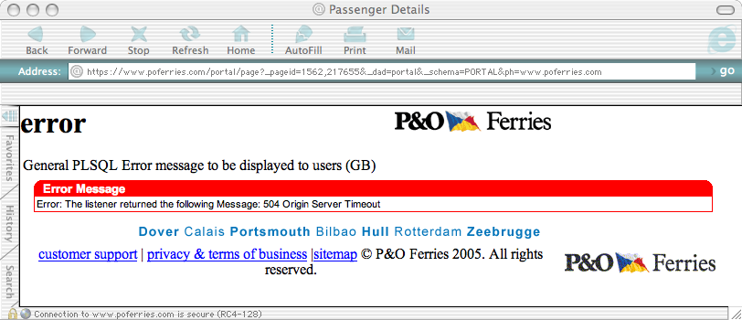
How many heuristics does this window violate?
P&O Ferries website. Graphic shows: “Error: General PLSQL Error message to be displayed to users (GB): Error: the listener returned the following Message: 504 Origin Server Timeout”

Slide 11
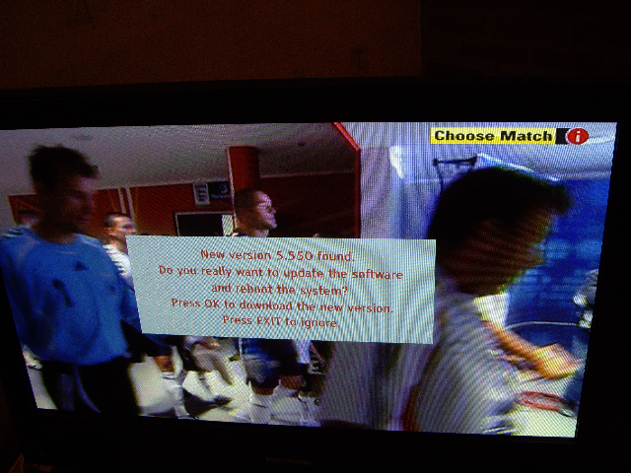
What about this message that appeared on my TV?
Text box on TV screen says: “New version 5.550 found. Do you really want to update the software and reboot the system? Press OK to download the new version. Press EXIT to ignore.”

Slide 12
Example 2: Cognitive Walkthrough
Informally based on Norman’s Action Cycle
  See next page
Involves team of analysts walking through an interaction
A form of analytical evaluation that, in principle, can be done before a running system exists.

Slide 13
Norman’s (1986) action cycle
Goal formation (domain)
Intention formation (for this system)
Action Specification (selecting action sequence to address goal)
Action Execution (doing it)
Perceiving system state
Interpreting system state
Evaluation (checking results against goals & intentions)

Slide 14
Gulfs…
execution
Of execution
Of evaluation
NB importance of feedback
evaluation

Slide 15
Key concepts
User has goals (domain-related)
User mixes (knowledge-based) planning and reaction to the state of the device in deciding what to do next
User has to get information from the display (or other computer output) to maintain awareness of system state … and learn effects of actions

Slide 16
Cognitive Walkthrough
Assumes user is learning about an interface in an exploratory way and is applying simple means-ends reasoning
Phase 1: a team of analysts agree task ‘scenarios’
Phase 2: each analyst considers each task in turn, looking for failure stories
Phase 3: compare notes and draw conclusions

Slide 17
Defining ‘task scenarios’
Who will the users be?
  Assumptions about prior experience and knowledge
What tasks are to be analysed?
  NB task refers here to domain goals
What is the correct action sequence for each task?
How is the interface defined?

Slide 18
Steps of walkthrough
Will the user try to achieve the right effect?
  Given their domain goal, will they identify the correct device goal?
Will the user notice the correct action is available?
  Is the action discoverable?
Will the user associate the action with the effect?
  Is it obvious the action addresses the goal?
If the correct action is performed, with the user see that progress is being made towards the goal?
  Is the feedback helpful?

Slide 19

Example
Will they try to achieve the right effect?
Will they notice step available?
Will they associate action with effect?
Will they see progress towards goal?

Slide 20
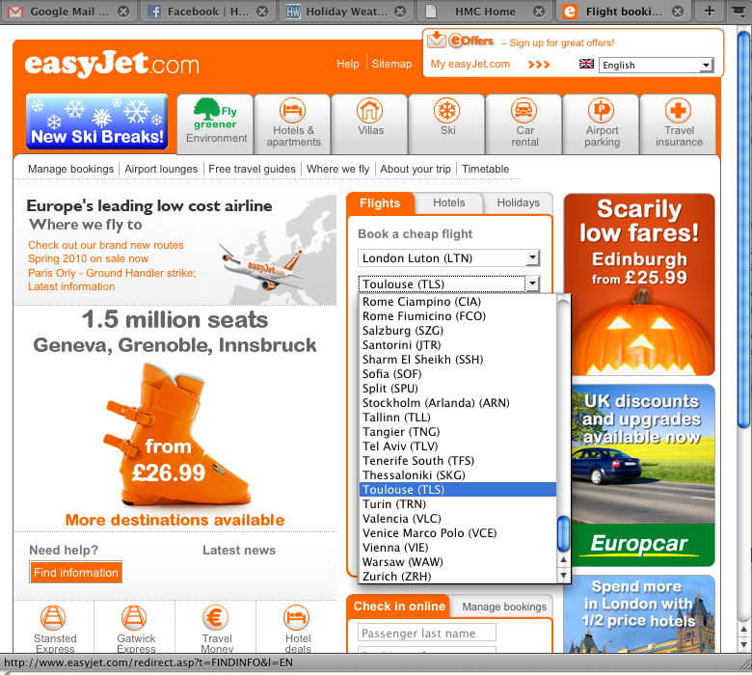
Page 2
Will they try to achieve the right effect?
Will they notice step available?
Will they associate action with effect?
Will they see progress towards goal?

Slide 21
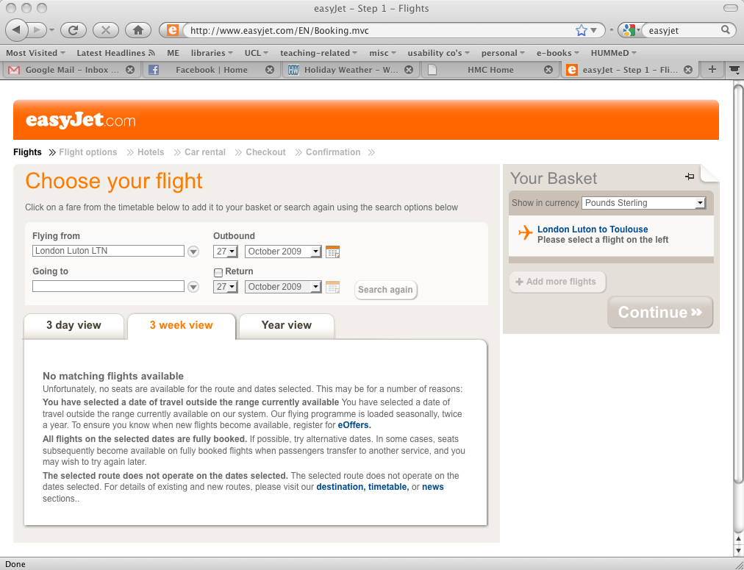
Page 3
Will they try to achieve the right effect?
Will they notice step available?
Will they associate action with effect?
Will they see progress towards goal?

Slide 22
Summary
There are a range of techniques…
  Demanding more or less skill of the analyst
  Applicable at different stages in design
  Yielding different kinds of insights about usability of systems
  All generally less resource-intensive than user studies, but more prone to evaluator bias

Slide 23
Questions or comments?
Read Sharp, Rogers & Preece Chapter 15.

